Slide 1
FACULTY ADVISOR
DEGREE AUDIT GUIDE FOR DOCTORAL STUDENTS

Slide 2
How to Access Degree Audit
Sign into MyTC
Underneath Employee Resources, locate the Degree Audit link in the left-hand column.
Click on the link.
‹#›

Slide 3
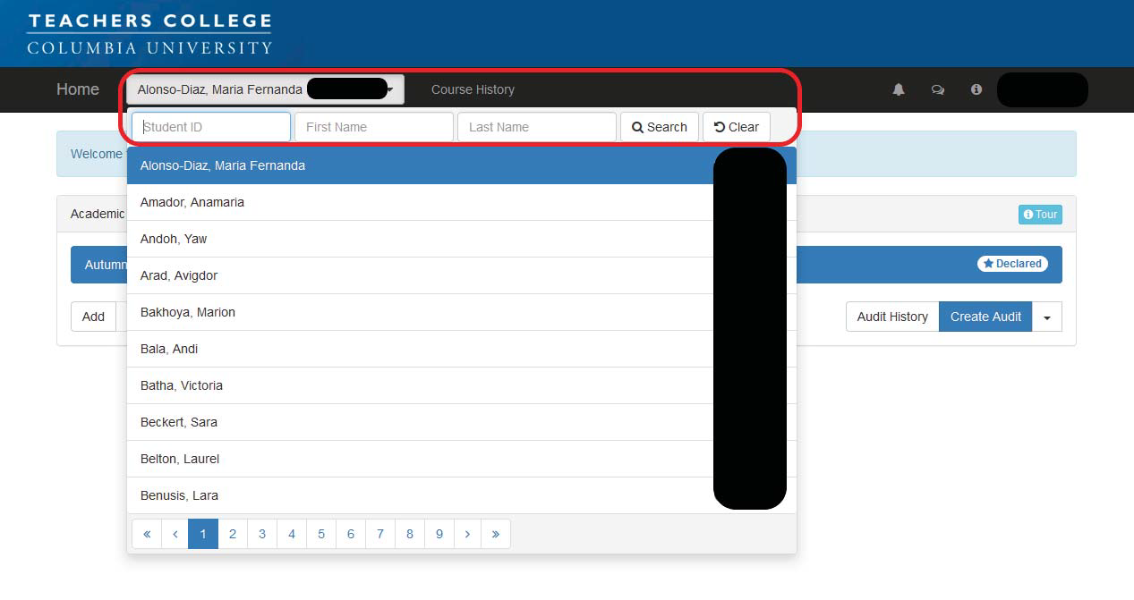
Student Name
TC ID#
Creating an Audit
Using the drop-down menu will display the Student Focus and the Search Bar
Enter the student’s information (name or TC ID) and click search or find the student under your “focused” list
Click on the student name to bring up the student’s academic goals page.
‹#›

Slide 4
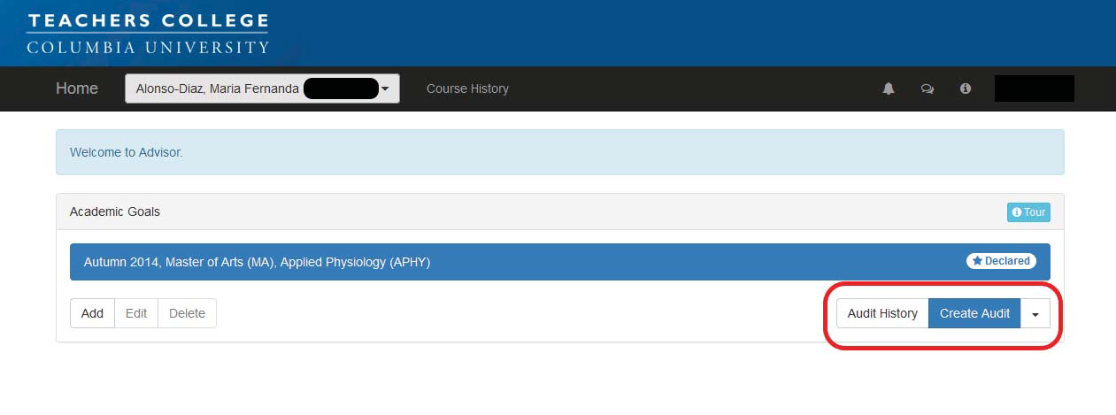
Creating an audit (cont.)
Audit History: Displays previously run audits along with the name of the person who ran them.
Create Audit: Runs an audit on the currently highlighted academic goal
Adding an Audit
Adding an audit is for students who are working on an "en passant" degree, or were admitted to an advanced certificate program through the Office of Admissions.
NOTE: If a student is going to file for an en passant degree/advanced certificate, please have them follow the directions for Masters degree/Advanced Certificate students on the website of the Office of the Registrar.
https://www.tc.columbia.edu/registrar/students/degree-information--degree-audit/how-to-file-for-a-masters-degree-or-advanced-certificate/
‹#›

Slide 5
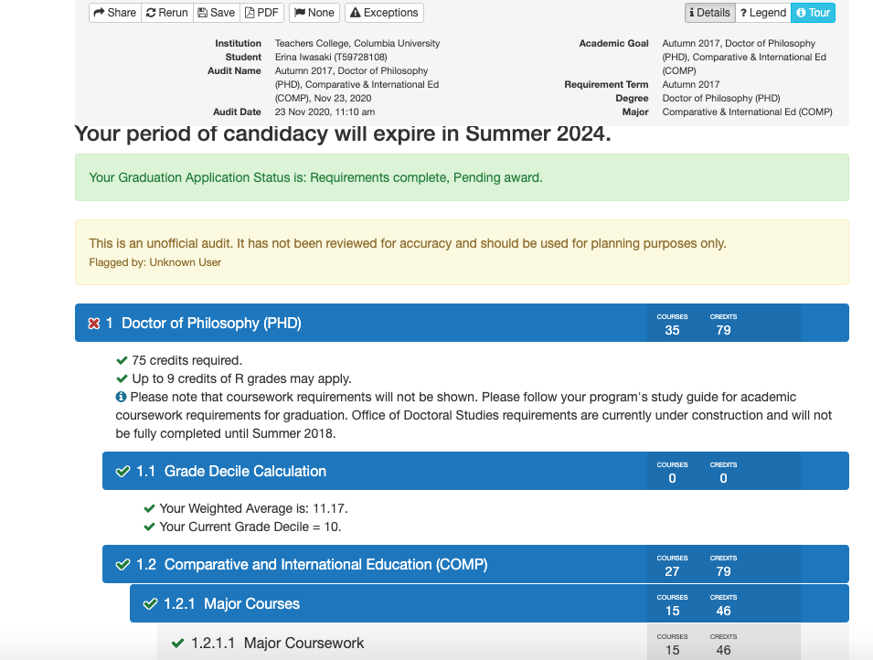
Current Audit Overview
See below the screen shot for a description of the different components of the audit page.
A
B
C
Actions: Students and faculty can share (this sends a copy to all who have access to this audit), rerun/refresh their audits (to see any changes made by faculty/staff), save an audit in the system, or make a pdf copy of their audits.
General Degree Information
Audit
‹#›

Slide 6
Note: The first time a user runs an audit, a tour will highlight the features of the degree audit.
‹#›

Slide 7
How to Add a Goal
Adding a goal will add another program (major) to your audit list. This does not constitute an official major/program change, but allows students to explore the options of adding programs.
1) Locate “Add Goal”
NOTE: Adding a goal will NOT replace or delete the declared major.
NOTE: Please only work on declared and officially approved en passant or advanced certificate audits. Students may sometimes add random audits for their own curiosity.
NOTE: Students admitted into an Advanced Certificate program must create the goal in the term of admission in order for the Audit to appear. The system will not automatically do it. Students planning on pursuing an en passant degree must also create their goal in order for the audit to appear.
Faculty advisors are welcome to create advanced certificate/en passant goals for their students.
7

Slide 8
How to Add a Goal (cont.)
2) Select the major
NOTE: The Year, Degree, and Major bar will turn blue.
You may not select an en passant program that leads to NYS certification.
If you need more information about multiple degree requirements, visit the link below:
https://www.tc.columbia.edu/policylibrary/associate-provost-enrollment-services/degree-requirements/
NOTE: If a student has a prior MA/MS at TC and are selecting an en passant MA or MS degree, please note that they may not use ANY coursework from the previous MA/MS towards the subsequent en passant MA or MS degree.
8

Slide 9
How to Add a Goal (cont.)
3) Click Save. The goal will be automatically named.
4) The goal will be listed on their home page
9

Slide 10
How to Prepare a Program Plan:
Location of the Program Plan begins in Section 1.2 (<Your Major’s Name>)
How to Move Courses
Based on the structure of the major program, students will be able to move courses that they have taken into requirement groups. The move course icon, which looks like a small anchor, appears next to requirement groups that allow for moving courses. Clicking on the anchor will open a panel in which you can move courses as needed.
NOTE: Names of specific sections in the Degree Audit/on the Program Plan may differ between programs. For example, not everyone may have the "Major Coursework" section.
‹#›

Slide 11
How to Move Courses (cont)
Click the down arrow to reveal course options. If a course does not appear in the list, it cannot be moved to satisfy that requirement.
In consultation with you, the student will place coursework they have taken in one of these four categories: major courses, research courses, broad and basic courses, elective courses.
Note: This is the default presentation of the Degree Audit. Your program director may have made the audit look more like your program’s guide. If you have questions, please talk with the program director or ODS.
‹#›

Slide 12
Click on the course you would like to move to the requirement. This will collapse the dropdown menu and only display the selected course.
Click on Move Course to complete the move. This will rerun the audit to reflect your move.
To cancel a move, just click on the x in the top right next to the tour button.
Your moved course will look as follows with an anchor: To lock your class in, click the anchor once to turn it into a pin. This will allow everyone who has access to the audit to view the change. Leaving it as an anchor will not allow anyone else to see the change.
Note: If the moved course already has a pin after you move it, you do not need to do anything.
12

Slide 13
Removing Moved Courses
To remove a moved course that was incorrectly placed, click the pin to the left of the course name.
This will turn the pin into a circle.
Then click the Rerun button at the top to refresh your screen and each course that had its pin removed will go back to the Unapplied section at the bottom of the audit.
You may now use the Move Course function to move that course to another section.
13

Slide 14
Course Planning
NOTE: This function should only be used by Ed.D./Ed.D. CTAS students.
Ph.D. students are expected to submit their Program Plan in the final term of coursework being used on the plan, so there will be no future planned courses.
ODS is presenting the steps on how to plan courses for your understanding only. Faculty advisors are not expected to do this for their Ed.D./Ed.D. CTAS students.
Adding future courses to the program plan
Click on the section (light shade bar) you wish to add a future course (do not click on the dark blue bars as they do not contain coursework - those are only section folders).
This will pop up the planning interface.
14

Slide 15
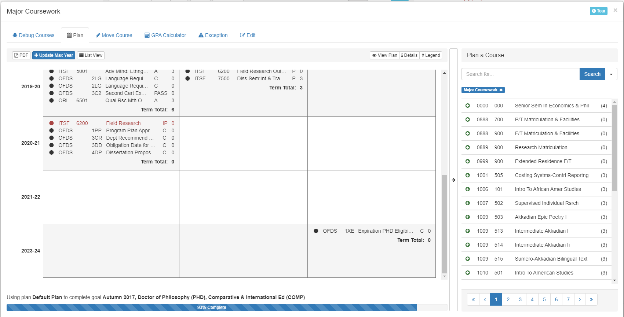
Course Planning Tool
Plan: shows that you are in the planning tab.
PDF - This will download a grid of every course on the transcript (including transfer credits) and ODS requirements.
Update Max Year: Allows you to add an academic year not listed on the grid.
List View: Switches the grid to a list style
Plan a Course: Area listing allowable courses that can fit in a chosen term and section.
Pages tab: If there are more pages to be seen, click on the numbers or arrows to see more courses.
15

Slide 16
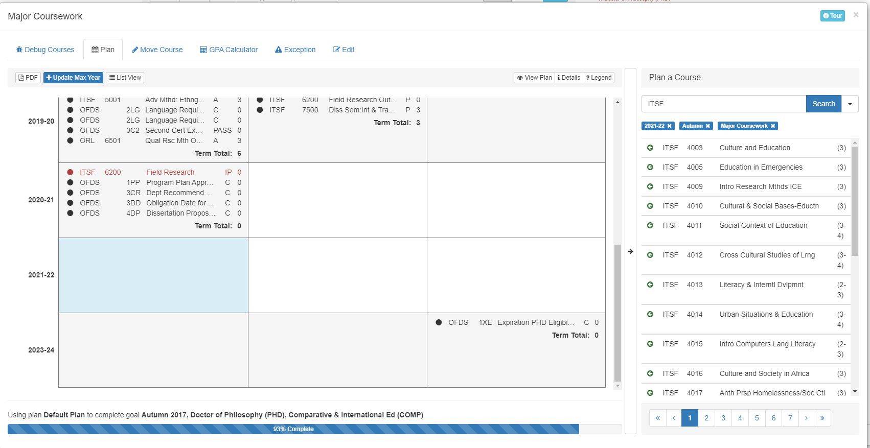
Adding a Planned Course
For every academic year, the left box is Autumn, the center box is Spring, and the right box is Summer
Click in the box where you plan to add a future course. This will highlight the box in blue and every course could potentially go there, will appear in the course list.
NOTE: Planning a course will not register you for that course. You will have to register as you normally would through the MyTC Portal once registration opens for that term.
16

Slide 17
Adding a Planned Course (cont.)
Use the search bar to narrow your search for the course you wish to add.
When you locate it, click it.
Use the add button to add the course.
(NOTE: If the course is variable credits, you can adjust the number of credits on the right)
17

Slide 18
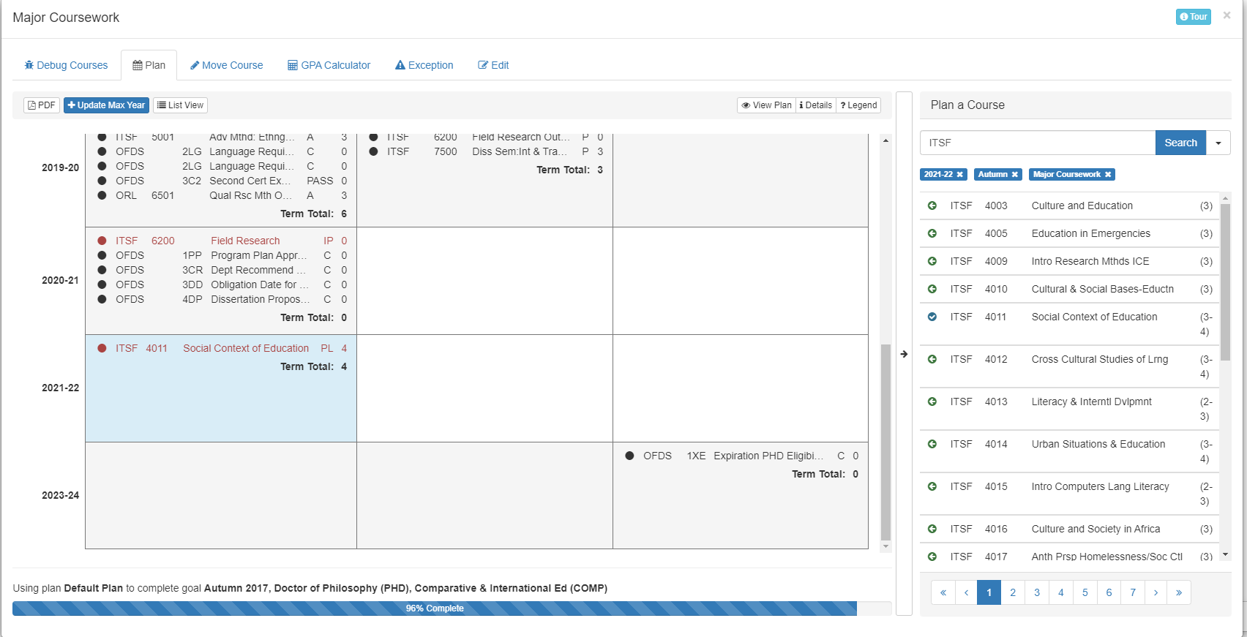
Adding a Planned Course (cont.)
You will now see the course in the selected box and in the course list, there will be a tiny blue check by that course.
If you wish to add another course to this term, you may continue the process. If you wish to change a term, please click the appropriate box.
If you are done, click the X in the upper right corner to exit the planning tool.
If the academic year you wish to add is not available, please go to the next page.
18

Slide 19
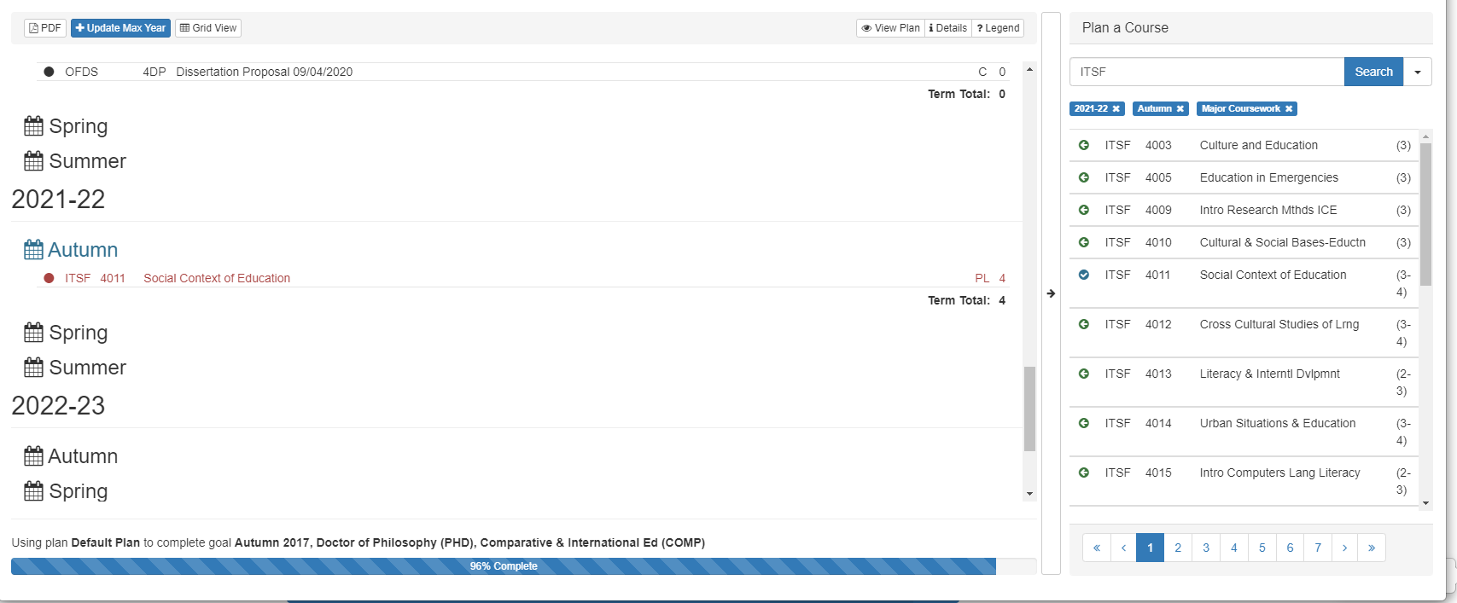
Adding Max Year
Type the year (ending in the Summer term) you wish to add. E.g., AY 2022-23, type 2023.
The grid will add that AY and you can add additional courses using the planning tool.
List View Option
You can select a term by clicking the appropriate calendar. (E.g., Autumn 2021 is highlighted here)
Then follow the same directions for selecting a course when in Grid View.
19

Slide 20
Removing a Planned Course
If you want to delete a planned course while in the planning tool, just click the course you want to delete.
A box will open up asking for confirmation. Click Remove to remove it.
If you decide to wait until you are back in the audit, you will be able to remove the planned course by clicking the red X to the right of the course. Then click Yes in the warning box to remove it.
20

Slide 21
Planned Courses on the Audit
Planned courses will stay on the degree audit until the start of the term of that planned course.
Once that term begins, the planned course will automatically fall into the Unsatisfactory or Uncompleted Courses section at the very bottom of the audit.
If they registered for that course, they may now move it to the section using the Move Course function. This is not an automatic feature where the actual course will replace the planned course.
21

Slide 22
Submitting a Program Plan to ODS
Ed.D./Ed.D. CTAS Students:
Ed.D. students are expected to submit their plan at approximately the time 75 credits have been completed (including approved transfer credits).
When all coursework has been moved and planned into the student’s degree audit, they are expected to consult with you to confirm that those are the minimum 90 points. necessary to meet their program requirements.
If you approve, please see the following page for next steps.
Ph.D. Students
Ph.D. students are expected to submit their plan in the term they are completing their final coursework listed on the program plan.
Planned coursework will not be accepted and should not be noted on the program plan.
When all coursework have been moved into their degree audit, students are expected to consult with you to confirm that these are the minimum points (most are 75, but some programs require more) necessary to meet their program requirements.
If you approve, please see the following page for next steps.
22

Slide 23
Approving a Program Plan
When you are ready to approve a program plan, there MUST be a green check under 1.2 <program name>. This shows that the program plan portion of the audit meets minimum academic requirements. If there is a red X here, do not approve the plan.
Please see below for what a typical audit will look like when the plan is complete.
Look for green check here
23

Slide 24
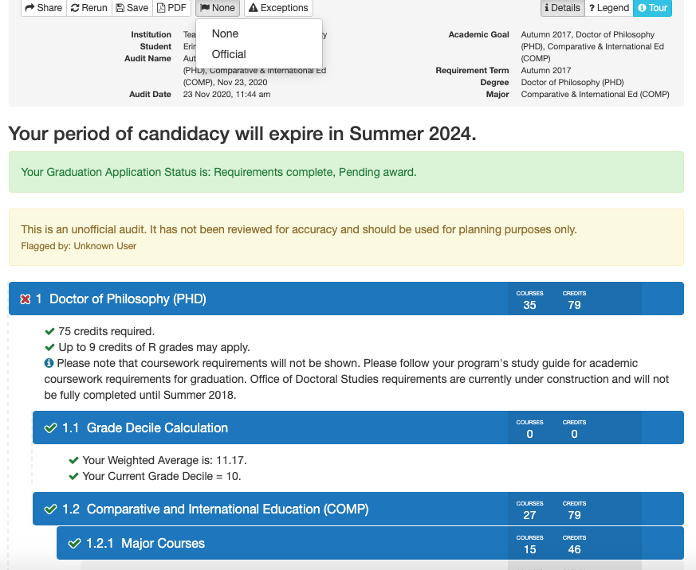
Approving a Program Plan (cont.)
To approve a plan, please click the Flag button that is between the PDF and Exemptions button. Default is None.
This will give you a drop down menu. All you have to do is click the Official option and you are done. ODS will automatically be notified of the approval and can begin processing the Program Plan.
24

Slide 25
Approving a Program Plan (cont.)
For Ed.D./Ed.D. CTAS students, if the plan changes for any reason after initial approval (such as the student not taking planned future coursework), subsection 1.2 <program name> will fall back to having a red X.
ODS will notify the student at the time of submitting their Intention to Defend that their Program Plan is no longer approved.
It will then be the student’s responsibility to reach out to you to update it and for you to approve a new Official plan.
NOTE: The student DOES NOT have to update their audit every term for your approval. Only two official reviews will be made.
25

Slide 26
Notifications
After approval of a Program Plan, you will see a small number appear to the right of this bell symbol on the home page. This will let you know there is a new notification. If you click the bell, the below information will appear with the number of students showing equalling the number next to the bell.
To open up your notifications history, please click the link above.
26

Slide 27
Notifications (cont.)
This list is ‘view only.’ You can’t go directly to a student’s audit from this list.
If you wish to keep them listed, you don’t have to do anything, however, the number of students that you’ve approved will remain next to the bell symbol.
If you would like to archive them from active viewing, you can do this by clicking the tag button under the ‘Self’ column for that student. It will be moved into the ‘Acknowledged’ notifications tab and the overall number of notifications will decrease.
If you click the trash can symbol under the ‘Delete’ column, it will be fully deleted and will not show up in any area. Please note that by clicking delete, you do not delete the actual audit, just the notification.
27

Slide 28
Understanding the Doctoral Student Degree Audit
The doctoral degree audit is broken into several subsections that address specific academic or ODS requirements.
NOTE: The Program Plan is the only subsection you and your doctoral students will be updating. All others are purely informational and read-only.
Summary of subsections:
<Program name> - this is where the student will process their Program Plan of Study.
Certification (Ed.D./Ed.D.CTAS) or Master of Philosophy (Ph.D.) - this is where you can see all items required for the student to become a Certified doctoral candidate or receive the Master of Philosophy degree. Specific information can be found in their degree Requirements Bulletin.
Period of Certification (Ed.D./Ed.D.CTAS) or Period of Eligibility (Ph.D.) - this tracks the amount of time remaining in their program. For Ed.D./Ed.D.CTAS students, if they are not yet certified, this subsection will be empty.
28

Slide 29
Understanding Your Degree Audit (Cont.)
Obligation (only visible when they become Obligated for Continuous Enrollment) - tracks how this requirement is met for each term they are Obligated.
Dissertation Proposal - lets you know if their Dissertation Proposal is fully submitted in ODS (a fully submitted proposal consists of the Dissertation Proposal Hearing Report form, IRB approval letter, and the proposal manuscript).
For PhD students, this section also tracks the Advanced Seminar.
Internship Requirement (only for Clinical Psych, Counseling Psych, or School Psych) - tracks completion of required Internship coursework.
Dissertation - tracks completion of oral defense and completion of degree.
NOTE: If you see anything that you believe is in error, please reach out to the Office of Doctoral Studies for assistance.
29

Slide 30
Access Course History
To quickly view all courses and past grades, select the “Course History” link located in the Home box.
Once selected, a list of courses and information will appear. The list will contain course title, grade (completion status), and the term in which the course was taken.
30

Slide 31
Have Questions or Concerns?
If you have any questions or concerns regarding the degree audit system, contact Ms. Heidi Rizzo at hr2459@tc.columbia.edu, or Mr. Russ Gulizia at gulizia@tc.columbia.edu.
Office Hours: Monday-Friday 9 a.m. – 5 p.m.
31

